Slide 1




Slide 2
Fine tune Bert for multi-class classification

Slide 3
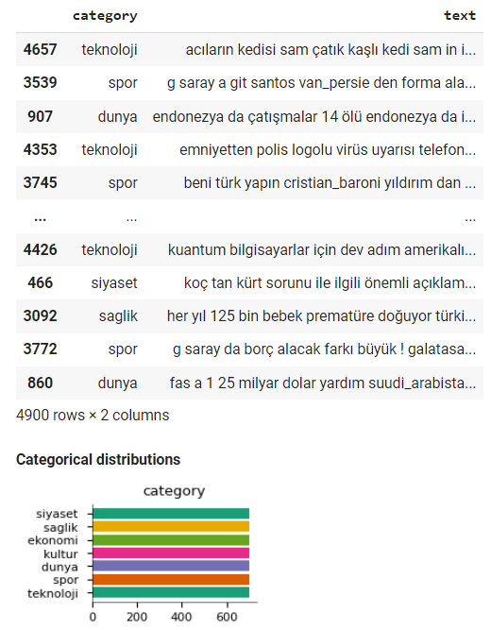
Multi-class classification
Download dataset
!wget https://raw.githubusercontent.com/savasy/TurkishTextClassification/master/TTC4900.csv
import pandas as pd
data= pd.read_csv("TTC4900.csv")
data=data.sample(frac=1.0, random_state=42)
data

Slide 4
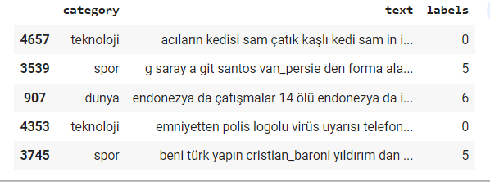
Multi-class classification
Map the labels to IDs :
labels=["teknoloji","ekonomi","saglik","siyaset","kultur","spor","dunya"]
id2label={i:l for i,l in enumerate(labels)}
label2id={l:i for i,l in enumerate(labels)}
data["labels"]= data.category.map(lambda x: label2id[x.strip()])
data.head()

Slide 5
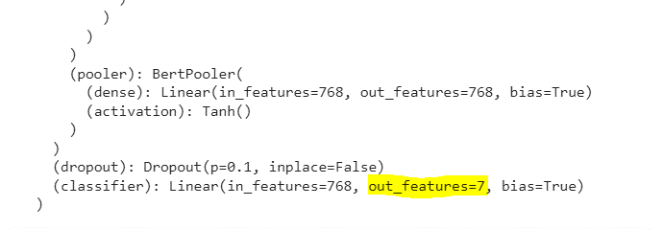
Multi-class classification
NUM_LABELS= len(labels)
7
from transformers import BertTokenizerFast, BertForSequenceClassification
tokenizer = BertTokenizerFast.from_pretrained("dbmdz/bert-base-turkish-uncased", max_length=512)
model = BertForSequenceClassification.from_pretrained("dbmdz/bert-base-turkish-uncased",
num_labels=NUM_LABELS,
id2label=id2label,
label2id = label2id)
model.to(device)

Slide 6
Multi-class classification
Prepare the training (%50), validation (%25), and test (%25) datasets:
Tokenize the sentences of three datasets and convert their tokens into integers:
SIZE= data.shape[0] # 4900 samples
## sentences
train_texts= list(data.text[:SIZE//2]) # [: 2450]
val_texts= list(data.text[SIZE//2:(3*SIZE)//4 ]) # [2450:3675 ]
test_texts= list(data.text[(3*SIZE)//4:]) # [3675 : ]
## labels
train_labels= list(data.labels[:SIZE//2]) # [: 2450]
val_labels= list(data.labels[SIZE//2:(3*SIZE)//4]) # [2450:3675 ]
test_labels= list(data.labels[(3*SIZE)//4:]) # [3675 : ]
## check the size
len(train_texts), len(val_texts), len(test_texts)
(2450, 1225, 1225)
train_encodings = tokenizer(train_texts, truncation=True, padding=True)
val_encodings = tokenizer(val_texts, truncation=True, padding=True)
test_encodings = tokenizer(test_texts, truncation=True, padding=True)

Slide 7
Multi-class classification
Designing the Dataset class:
from torch.utils.data import Dataset
class MyDataset(Dataset):
def __init__(self, encodings, labels):
self.encodings = encodings
self.labels = labels
def __getitem__(self, idx):
item = {key: torch.tensor(val[idx]) for key, val in self.encodings.items()}
item['labels'] = torch.tensor(self.labels[idx])
return item
def __len__(self):
return len(self.labels)
train_dataset = MyDataset(train_encodings, train_labels)
val_dataset = MyDataset(val_encodings, val_labels)
test_dataset = MyDataset(test_encodings, test_labels)

Slide 8
Multi-class classification
Define training argument
from transformers import TrainingArguments, Trainer
training_args = TrainingArguments(
output_dir='./TTC4900Model',
do_train=True,
do_eval=True,
num_train_epochs=3,
per_device_train_batch_size=16,
per_device_eval_batch_size=32,
warmup_steps=100,
weight_decay=0.01,
logging_strategy='steps',
logging_dir='./multi-class-logs',
logging_steps=50,
evaluation_strategy="steps",
eval_steps=50,
save_strategy="steps",
fp16=True,
load_best_model_at_end=True
)

Slide 9
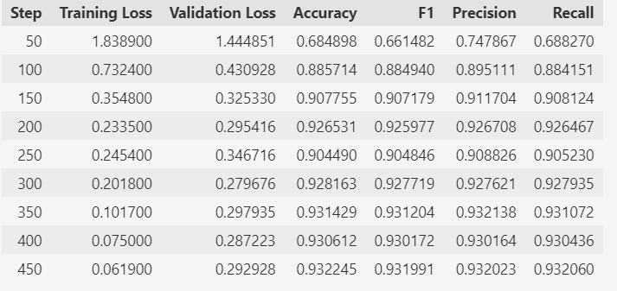
Multi-class classification
Define monitoring metric:
Instantiate the Trainer object:
from sklearn.metrics import accuracy_score, precision_recall_fscore_support
def compute_metrics(pred):
labels = pred.label_ids
preds = pred.predictions.argmax(-1)
Precision, Recall, f1, _ = precision_recall_fscore_support(labels, preds, average='macro')
acc = accuracy_score(labels, preds)
return {
'Accuracy': acc,
'F1': f1,
'Precision': Precision,
'Recall': Recall
}
trainer = Trainer(
model=model,
args=training_args,
train_dataset=train_dataset,
eval_dataset=val_dataset,
compute_metrics= compute_metrics
)
Trainer.train()

Slide 10
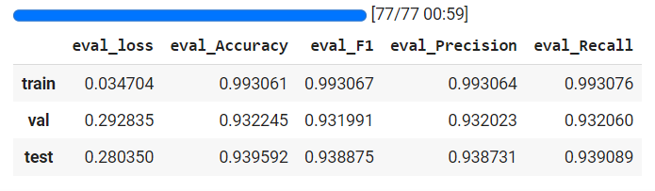
Multi-class classification
Evaluate the fine-tuned model on three dataset splits:
q=[trainer.evaluate(eval_dataset=data) for data in[train_dataset, val_dataset, test_dataset]]
pd.DataFrame(q, index=["train","val","test"])

Slide 11
Multi-class classification
Define predict function:
Inference using predict function:
Save the model:
def predict(text):
inputs = tokenizer(text, padding=True,truncation=True, max_length=512, return_tensors="pt").to("cuda")
outputs = model(**inputs)
probs = outputs[0].softmax(1)
return probs, probs.argmax(),model.config.id2label[probs.argmax().item()]
text = "Fenerbahçeli futbolcular kısa paslarla hazırlık çalışması yaptılar" # englis translate : Fenerbahce football players made preparations with short passes
predict(text) # sports
(tensor([[7.3232e-04, 4.8926e-04, 5.1626e-04, 2.9002e-04, 3.7789e-04, 9.9702e-01, 5.6950e-04]], device='cuda:0', grad_fn=<SoftmaxBackward0>), tensor(5, device='cuda:0'), 'spor')
model_path = "turkish-text-classification-model"
trainer.save_model(model_path)
tokenizer.save_pretrained(model_path)

Slide 12
Multi-class classification
Run model inference using pipeline module:
from transformers import pipeline, BertForSequenceClassification, BertTokenizerFast
model_path = "turkish-text-classification-model"
model = BertForSequenceClassification.from_pretrained(model_path)
tokenizer= BertTokenizerFast.from_pretrained(model_path)
turkish_classifier= pipeline("text-classification", model=model,tokenizer=tokenizer)
turkish_classifier("Dolar ve Euro bugün yurtiçi piyasalarda yükseldi") # Dollar and Euro in domestic markets today rose
# ekonomi == economy
[{'label': 'ekonomi', 'score': 0.9893269538879395}]

Slide 13


